Slide 1
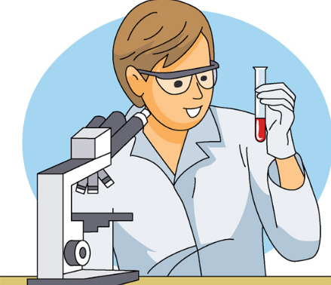
Chapter 01 Science Inquiry
Intro to Scientific Method
Types of Investigation

Slide 2
Date: | Human Biology Year 12 ATAR
Do Now Complete the past exam question given, under test conditions (not for actual marks) Lesson Agenda 1: Do Now 2: Intro to Scientific Method/Types of Investigation/Planning Valid Experiments 3: Work on Review Worksheet 4: Lesson summary and wind-up Suggested Study Complete review worksheet, mark and correct using answer key on Connect. Read through today’s notes and textbook section NEXT LESSON Finishing off work from today Second hand data analysis question Prepare for practical assessment | Learning Aims: Describe different types of investigation used in human health and medical research, and give examples of their application. Discuss and apply aspects of planning a valid investigation relevant to human health research.
 | Key Vocabulary Validity Reliability Accuracy Error Bias Placebo Control Sample Variables

Slide 3
What is science?
Two aspects:
A process of inquiry
a way of finding out about things.
Scientists observe the world and come up with ideas:
About connections between things
About why things happen
Scientists use a systematic process “the scientific method” to explore possible connections and prove/disprove them.
A body of knowledge
Gained by systematic observation and testing of ideas.

Slide 4
In human biology and medical research…
Inquiry, for example:
Formulating and testing drugs
Studying human health over time
Gathering data on human systems
Leads to:
medical advances and more accurate understandings – contributes to a body of knowledge

Slide 5
Types of Investigation

Slide 6
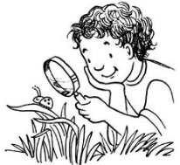
Observations
Using senses and measuring equipment
Gathering, collating and analysing data gathered
Looking for patterns and relationships within the data.
Often observations are the first step in forming a testable hypothesis which then leads to further research using other techniques.
Examples:
Observation of animal behaviour
Discovery of Helicobacter pylori
Gastric ulcers used to be attributed to stress.
Barry Marshall and Robin Warren observed that in almost all cases, a particular type of bacterium (Helicobacter pylori) was present.
They were then able to formulate and test the hypothesis that these bacteria were the cause of gastric ulcers.

Slide 7

Surveys
Collection of data from a large number of people.
Questionnaire or interview.
Can reveal patterns of behaviour, provide ideas about connections (eg lifestyle and heart disease)
Can be used to assess how an intervention is working (eg: are people eating the recommended amount of fruit and veg after the 2 and 5 campaign.
Often used in conjunction with other data collection methods.
Can also be used to form testable hypotheses for further research.

Slide 8

Trial and Error
Systematic
Testing things in turn
Can be prolonged/time consuming
Keeping very accurate records is important
Is then used to formulate a hypothesis for testing
Example: testing different chemical compounds from plants, to see whether they have an antibiotic effect on bacterial colonies

Slide 9
Case Studies
In depth investigation and report of a specific situation.
Can be used to track the progress of a disease in an individual, to learn more about disease in general, or to confirm other data.
Have limitations – can be too narrow in view, lack validity and repeatability.

Slide 10
Longitudinal Studies
Conducted over a long period
Gathers data repeatedly:
Via observation and measurement and/or
Via survey
Picture of change over time
Can establish links between lifestyle and health which can then be further tested.
Examples:
Longitudinal studies of women’s health.
Longitudinal monitoring of smoking habits and disease.

Slide 11
Controlled Experiments
Designed to investigate relationships between factors.
Variables carefully controlled.
Validity carefully monitored.
Tests a hypothesis
Eg: People who take the drug “Pressurego” show a significant reduction in systolic blood pressure compared to people who do not take “Pressurego”.
Data undergoes statistical analysis to determine probability that hypothesis is correct.
Process used in clinical trials to determine safety and efficacy of medications.
Determines whether there is a clear, provable connection between two variables.

Slide 12
Scientific Method and Planning Valid Investigations

Slide 13
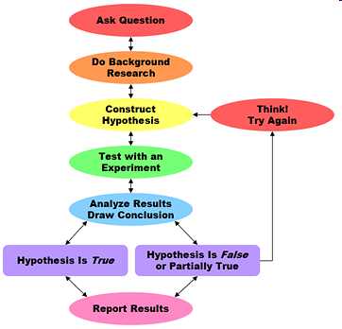
Scientific Method Overview
A way to investigate, that allows accurate assessment of whether a hypothesis is supported by the data, incorrect or inconclusive.
The process used for rigorous testing of cause and effect in controlled experiments
Each experiment/investigation adds a small piece to a much larger body of knowledge.

Slide 14
Planning a controlled experiment using Scientific Method
Elements to consider:
Literature review
Safety
Ethics
Formulating a hypothesis
Selecting and controlling variables
Ensuring validity
Ensuring accuracy
Ensuring reliability
Minimising sources of error
Avoiding bias
Imagine that you are a researcher looking at new drug to treat high blood pressure…. “Pressurego”.
How would you design and experiment to see if it was effective?

Slide 15

Literature Review
Reading previous research about
the subject.
Helps to define the problem/question
Prevents unnecessary duplication – can build on prior knowledge.
To assess research methods used, and learn from these
Helps scientists to related findings to prior body of knowledge
Allows consideration of areas for further research
EG: Before testing “Pressurego” you would find and read all of the available research about current blood pressure medications and their effects. You’d check and see whether similar drugs had been tested and what the results were.
You’d look at the methods used and how well these worked.

Slide 16

Safety
EG: Before testing efficacy of “Pressurego” on humans you would need to:
Test the drug on animals eg rats to check for side effects and other safety issues
Test the drug on a small sample of consenting adults to check further for safety.
Important to consider safety of research team and participants.
Protective clothing
Ensuring participants feel safe and comfortable
Access to medical care/first aid if needed
Medications are usually tested:
on animals first (eg rats/mice) to check for safety and efficacy.
On a small sample of people who have consented to check further for safety
On larger groups to check for efficacy once safety has been established.

Slide 17

Ethics
EG: Before testing efficacy of “Pressurego” on humans you would need to:
Ensure the people who were participating were doing so voluntarily and were aware they can stop at any time.
Ensure that they understand the experiment and the expected effects of the medication so that they are able to give informed consent.
Ensure that testing had occurred in animals and small groups of consenting people before testing more broadly to minimise risk of harm
Note –animal research also needs to be valid, humane, justifiable and considerate.
Ensure the participants can’t be individually identified in the published results.
A set of moral principles. For experiments involving people:
Voluntary participation
Informed consent
No risk of harm
Confidentiality
For animal research:
Valid
Humane
Justifiable
Considerate

Slide 18
Formulating a hypothesis
Eg: We want to test whether “Pressurego” is effective at lowering blood pressure in people with high blood pressure.
We could have a hypothesis: “That Pressurego reduces blood pressure” – compared to what?
We could say “People who take Pressurego have lower blood pressure than before they took it”
In medical research a “case-control” approach is used – comparing one group to another:
“People who take Pressurego show a reduction in blood pressure compared to people who do not take it”
Should include a statement of how one variable affects another variable.
Variables should be measurable.

Slide 19
Selecting Variables
When selecting variables to test “Pressurego” with the hypothesis that:
“People who take Pressurego show a reduction in blood pressure compared to people who do not take it”
Independent Variable: whether or not Pressurego is administered.
Dependent Variable: blood pressure over time.
Controlled Variables: things kept the same in both the experimental group and the control group: age, gender and background health of participants, existing high blood pressure, no other medication being used.
Control Sample: In this case, one group would get the Pressurego. This is the experimental group. The other group would not get Pressurego. This is the control sample. They would get a tablet exactly the same in every way, except without the drug. This way, you can be sure any changes seen in the experimental group are due to the medication.
Should be linked to hypothesis being tested.
Independent Variable: the thing being changed.
Dependent Variable: the thing that changes in response.
Should be:
Measurable
Clear
Other variables should be controlled (kept the same)
Controlled Variables: everything other than the ID and DV should be the same.
Control Sample: a sample where the independent variable is not present. Used as a comparison

Slide 20
Ensuring Validity
In the Pressurego experiment:
“People who take Pressurego show a reduction in blood pressure compared to people who do not take it”
We controlled variables such as age of participants in each group, no other pre-existing health conditions, ensuring that both groups had high blood pressure, etc. If we didn’t control these variables, we wouldn’t know for sure if Pressurego was the reason for the results.
We used a Control Sample so we could compare. This also allows us to be sure that the changes in the experimental group are due to Pressurego, making it more valid.
If we used a different medication, or tested heart rate instead, we wouldn’t be testing the hypothesis, so the experiment would not be valid.
Validity:
how well the experiment tests what it is supposed to test.
Does it test the hypothesis?
Are other variables that could affect the results controlled?
Can you clearly compare to establish cause and effect?

Slide 21

Valid experiments:
Have all variables well controlled, except for the IV and DV being tested.
Have a neutral control sample to compare.
Have variables that are measurable/quantifiable, which match the hypothesis
This allows us to be confident that any change to the DV must be due to the IV, and not another factor.

Slide 22
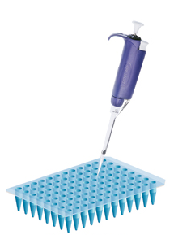
Ensuring Reliability
In the Pressurego experiment we could ensure reliability by ensuring that the size of the experimental and control groups was large enough. If you get the same results with hundreds of people in each group, you can be more sure of the results – it’s far less likely to be a coincidence than if there is one person in each group.
We could also repeat the experiment multiple times. If the results are the same each time then we can be confident that the cause and effect relationship is reliable.
Reliability:
confidence that the results will show the same thing each time the experiment is run.
Helped by large sample sizes, repeated trials.
Can help overcome problems with uncontrolled variables/outliers in the results.

Slide 23
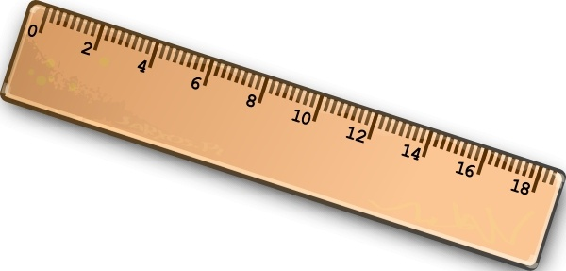
Ensuring Accuracy
Accuracy:
How close the measured data is to the exact value.
Depends on the measurement equipment used.
Correctly calibrated (works properly)
Sensitive enough (so using mm on a ruler to measure something small, not cm)
In the Pressurego experiment we could ensure accuracy by:
making sure the dosage is measured correctly – eg each tablet has exactly the same dose, measured carefully.
Making sure blood pressure is measured by experienced nurses, using well-calibrated, high quality equipment

Slide 24
Minimising sources of error
We can minimise error in the Pressurego experiment by:
Carefully reviewing the experiment design to ensure it is free from systematic error.
Ensuring accurate data entry (possibly using an automatic system that records onto computer directly from measuring equipment) to avoid human error, or double checking measurements
Random error can’t be avoided, but if it occurs it is important that it is recorded and taken into account when looking at the accuracy of the results.
Error:
mistakes in the experiment or data collection that affect the results:
Systematic Error: mistakes in experimental design
Human Error: data entry mistakes, misreading equipment etc.
Random Error: unpredictable eg environmental conditions

Slide 25
Avoiding Bias
Bias is a preference to see a particular result.
Scientists try to be objective.
Try not to let their own thoughts, feelings and opinions to influence their experiment
Keep an open mind about what the results may be
Try not to have conflict of interest eg: accepting money or favours for the result to be a certain way.
Allow other scientists to review their experimental design, results and conclusions. This is the peer review process. Other scientists can decide whether the experiment is published based on whether it meets standards of validity/reliability etc.
We can avoid bias in the Pressurego experiment by:
Not accepting money or favours from the manufacturers of Pressurego.
Ensuring other scientists can review your experimental design, results and conclusions, but submitting the results for peer review.
Making the experiment a “double blind” experiment – more on this later.

Slide 26
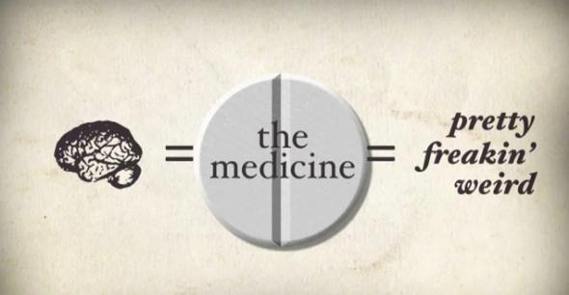
Bias and the Placebo effect
Placebo effect is a type of bias that can occur
“trick of the mind”
Scientists or experiment participants may unconsciously introduce bias into the results.
Eg: people receiving a medication may believe they will get better, and therefore report feeling better even if the symptoms don’t go away.
Scientists may believe they will see a set of results and will therefore unconsciously introduce measurement error, affecting the results so they see what they expect to see.

Slide 27
Avoiding placebo effect
Blind studies:
Neither the test group nor the controls know whether they are getting the drug or the placebo – the experimenter does not let them know until after all data has been gathered and analysed.
Double Blind studies:
None of the people being tested, the control group, OR the scientist know which group is getting the drug and which group is getting the placebo until after the experiment.
The drug and the placebo (the fake medication) are put in bottles labelled “A” and “B” by an independent person. This person does not let the experimenters or the testing groups know which is the drug and which is the placebo (fake) medication until after all data has been gathered and analysed.
We can avoid placebo effect in the Pressurego experiment by:
Getting an independent person to put the Pressurego tablets in one container, and the tablets with no Pressurego (eg sugar pills) in another container, then label the containers A and B, but not tell anyone which is which until after the results are in. If the Pressurego really works, the experimenter should be able to tell from the results which group got the real medication, and can confirm this with the third party.

Slide 28
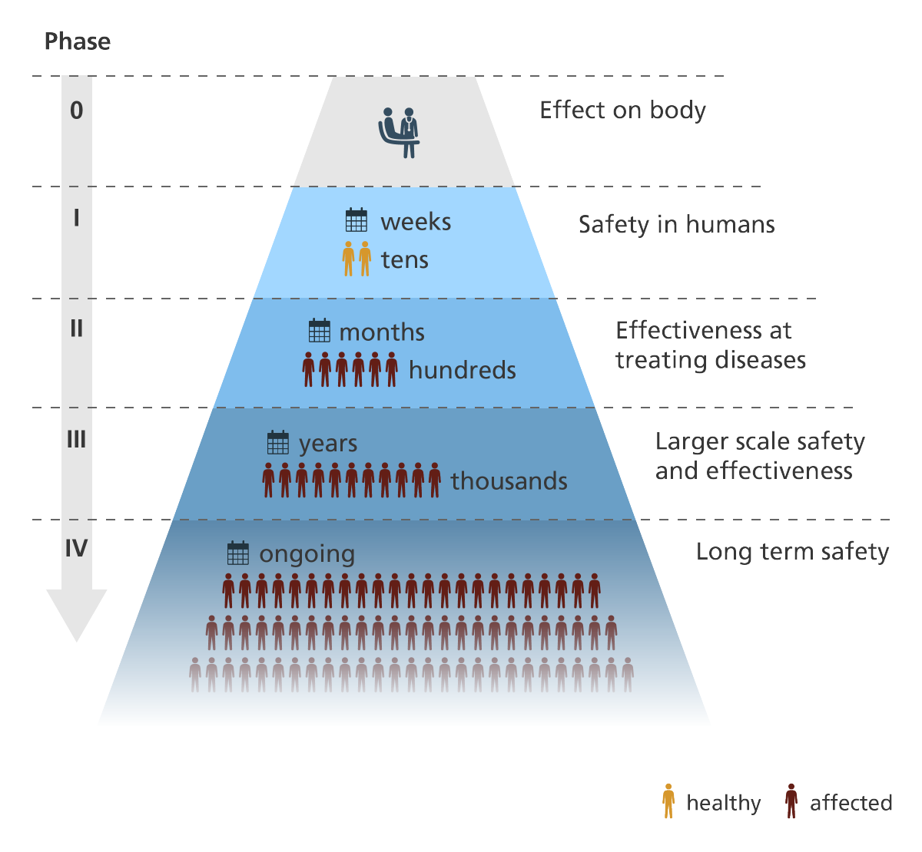
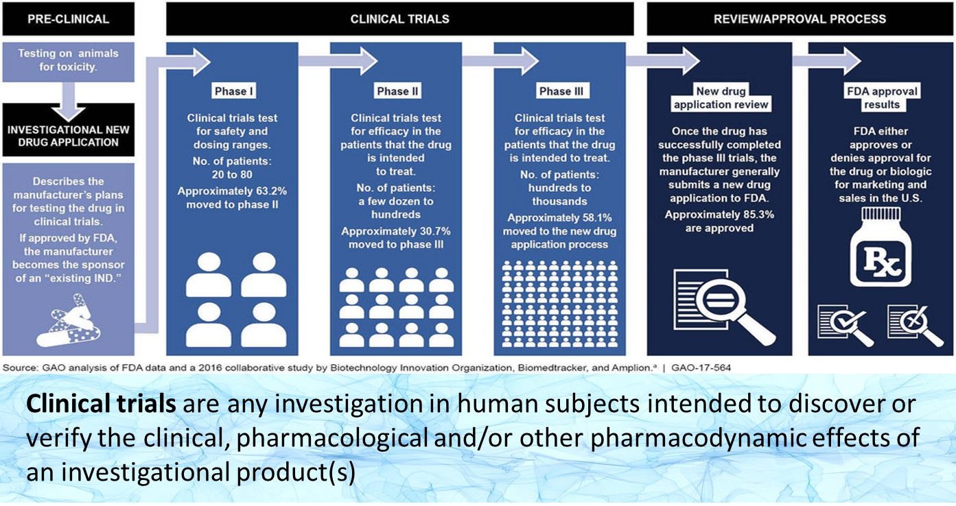
The road to investigating a new medication and getting it approved for use.

